Slide 1
ARCS: Accurate Rotation and Correspondence Search
Liangzu Peng, Manolis C. Tsakiris, Rene Vidal
Oral Session 3.1.3 & Poster Session 3.1 @ CVPR 2022
Video Recording Date: June 1, 2022
In-Person Presentation Date: June 23, 2022

Slide 2
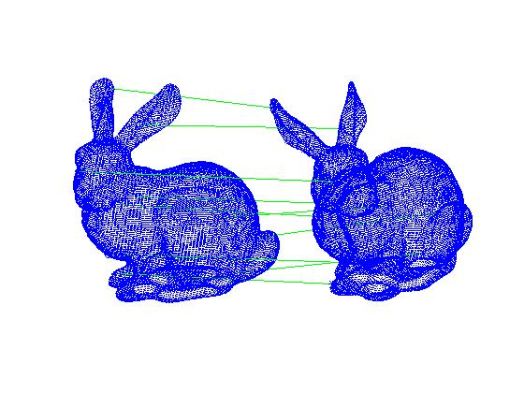
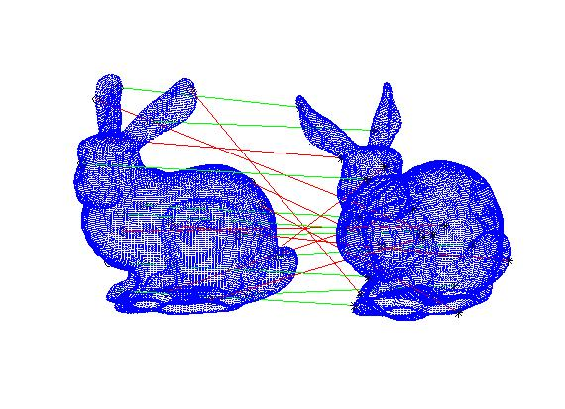
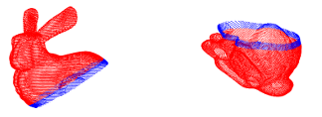
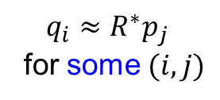
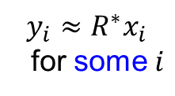
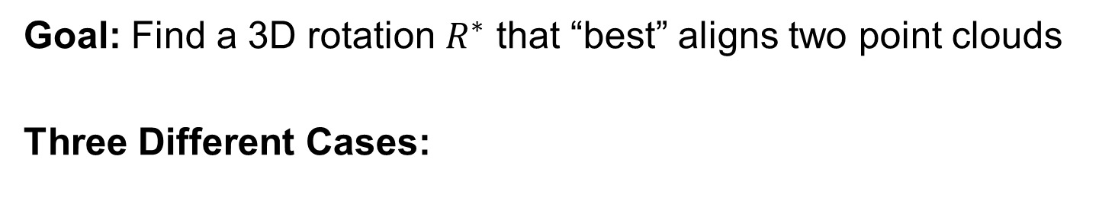
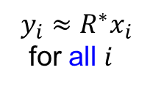
Rotation Search: Problem Setup
Goal: Find a 3D rotation $R^{∗}$ that “best” aligns two point clouds
Three Different Cases:
(2) With Outliers
(3) Correspondence-Less
(Partially Overlapped)
(1) Outlier-Free
$$y_{i}≈R^{∗}x_{i}$$
for all $i$
$$y_{i}≈R^{∗}x_{i}$$
for some $i$
$$q_{i}≈R^{∗}p_{j}$$
for some $(i,j)$

Slide 3
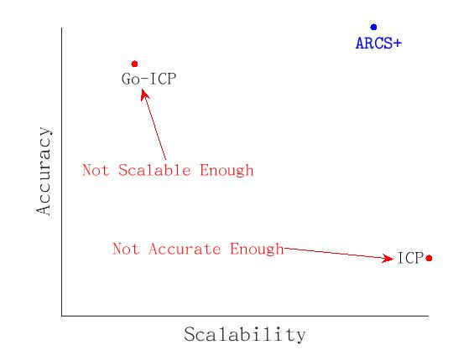
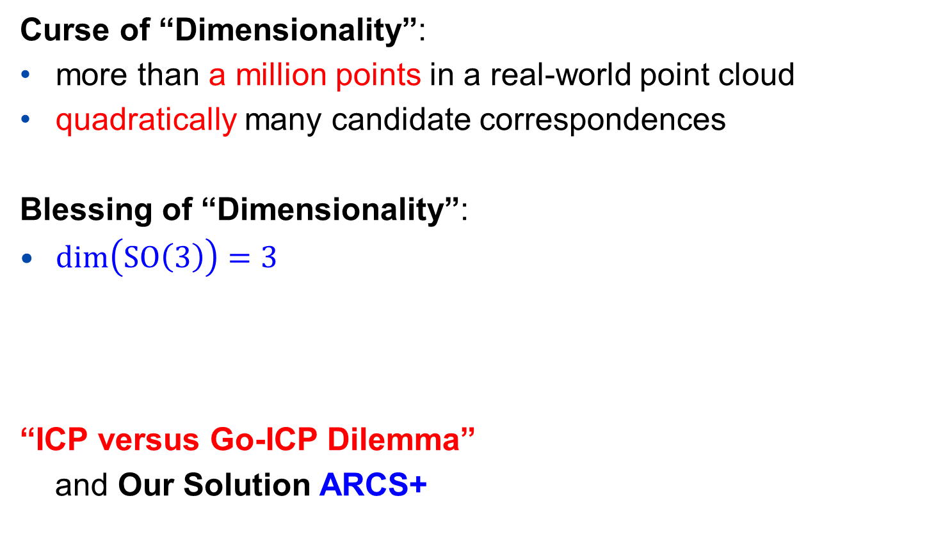
More on Case 3 (Correspondence-Less）
Curse of “Dimensionality”:
more than a million points in a real-world point cloud
quadratically many candidate correspondences
Blessing of “Dimensionality”:
$\dim\left(SO\left(3\right)\right)=3$
“ICP versus Go-ICP Dilemma”
and Our Solution ARCS+
Go-ICP: J. Yang, H. Li, D. Campbell, Y. Jia, “Go-ICP: A Globally Optimal Solution to 3D ICP Point-Set Registration”, TPAMI 2016.
ICP: P.J. Besl, N.D. McKay, “A Method for Registration of 3-D Shapes”. TPAMI 1992.

Slide 4
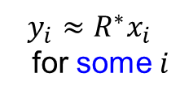
The ARCS+ Algorithm: Step 1
Step 1: Establish correspondences (by matching points whose norms are close)
Key Idea: Step 1 can be implemented in linear-logarithmic time (in input size)
Step 1 reduces Case 3 to Case 2, a task of Robust Rotation Search
$$y_{i}≈R^{∗}x_{i}$$
for some $i$

Slide 5
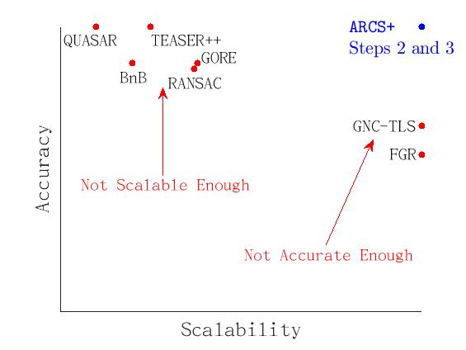
More on Case 2 (Robust Rotation Search)
“Scalability versus Accuracy Dilemma”
and Our Solution (ARCS+, Steps 2 and 3)

Slide 6

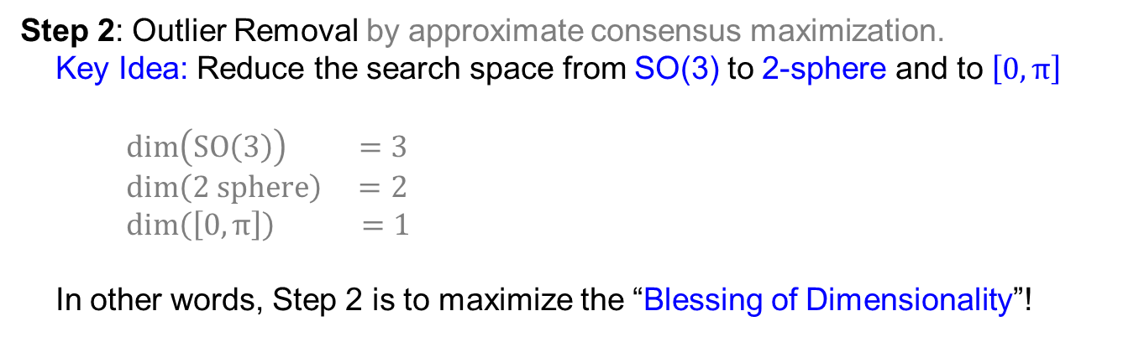
ARCS+: Steps 2 and 3 for Case 2 (Outliers)
“Scalability versus Accuracy Dilemma”
and Our Solution (ARCS+, Steps 2 and 3)
Step 2: Outlier Removal by approximate consensus maximization.
Key Idea: Reduce the search space from SO(3) to 2-sphere and to $\left[0,π\right]$
$\dim\left(SO\left(3\right)\right) =3$
$\dim\left(2 sphere\right) =2$
$\dim\left(\left[0,π\right]\right) =1$
In other words, Step 2 is to maximize the “Blessing of Dimensionality”!
See our paper for references and a review on prior works.

Slide 7
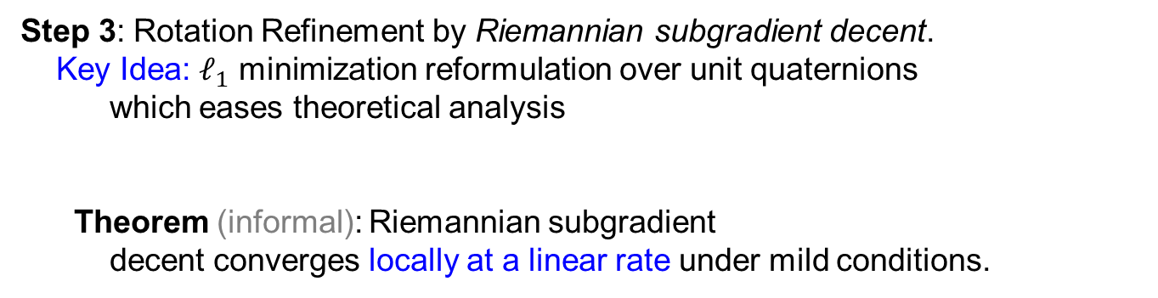
ARCS+: Steps 2 and 3 for Case 2 (Outliers)
“Scalability versus Accuracy Dilemma”
and Our Solution (ARCS+, Steps 2 and 3)
Step 3: Rotation Refinement by Riemannian subgradient decent.
Key Idea: $ℓ_{1}$ minimization reformulation over unit quaternions
which eases theoretical analysis
Theorem (informal): Riemannian subgradient
decent converges locally at a linear rate under mild conditions.
See our paper for references and a review on prior works.

Slide 8
ARCS+: Scalability & Accuracy in Numbers
ARCS+ is correspondence-free and can handle:
more than a million number of points with 2 overlapping points without noise
roughly ten thousand points with 20% overlaps under small noise
ARCS+ (Steps 2 and 3) can handle:
ten million point pairs with 0.03% inliers
See our paper for more formal experimental report.

Slide 9
More Information
Research supported by NSF Grants 1704458 and 1934979, and by the Northrop Grumman Mission Systems Research in Applications for Learning Machines (REALM) initiative.
Vision Lab @ JHU http://www.vision.jhu.edu
Center for Imaging Science @ JHU http://www.cis.jhu.edu
Mathematical Institute for Data Science @ JHU http://www.minds.jhu.edu
Thank You!

